Slide 1
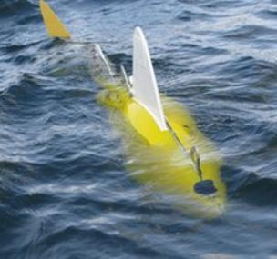
Why robotic fish is important
Huge effort on monitoring the pollution level
Northern Spain
Real-time monitoring of pollution with robo-fish containing sensors
Phenols and heavy metals such as copper and lead, as well oxygen levels and salinity
Greatly reduce the cost of treating water pollution

Slide 2
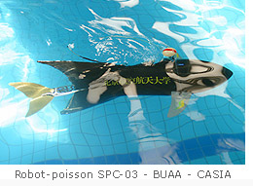
Why robotic fish is important
Exploration of underwater object
Underwater archaeological exploration
Underwater photography
Cartography of the underwater funds
Transport of small objects

Slide 3
Problem on robotic fish
Battery life
Only few hours for most model except days
Bio-compatible, material
The material that should be compatible with marine life
Mode of motion
Inherent kinematic constrain
The technique to avoid collision and define the path and motion of robotic fish

Slide 4
Reference
http://www.bbc.com/news/science-environment-18062235
http://www.robotic-fish.net/index.php?lang=en&id=robots

Slide 5
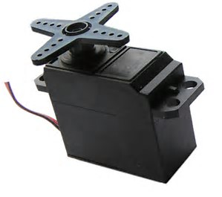
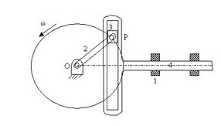
Actuators
Tenden and Cable
3 type of Electric motors
DC motor
DC servomotor
rotates to the commanded position but then the servomotor rests
Scotch-yoke mechanism
converting the linear motion of a slider into rotational motion

Slide 6

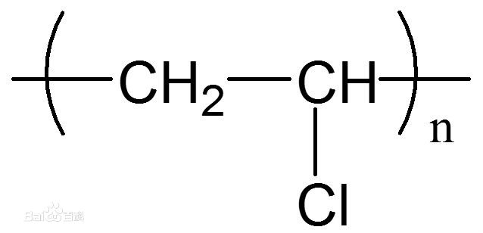
Skin of Robotic Fish
PVC
Water irrigation system. (like a file)
Make the robot be lighter
Easy for making a product (can be cut, drilled)
A good weight-to-strength ratio

Slide 7
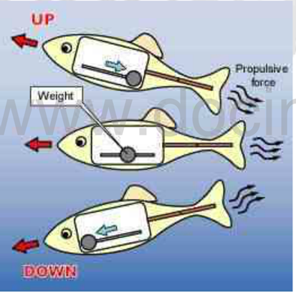
Motion of robotic fish(upward & downward)
Mass center adjuster
Changing center of mass
To make the robotic upward & downward
Pros
Unchanged density
Easy to control
Stable

Slide 8
Choose the one you prefer

Slide 9
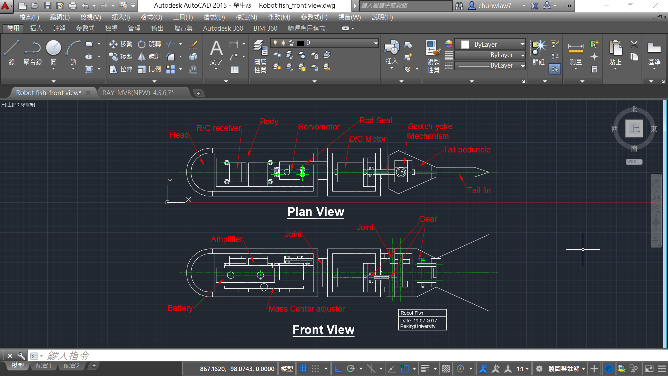
Design

Slide 10
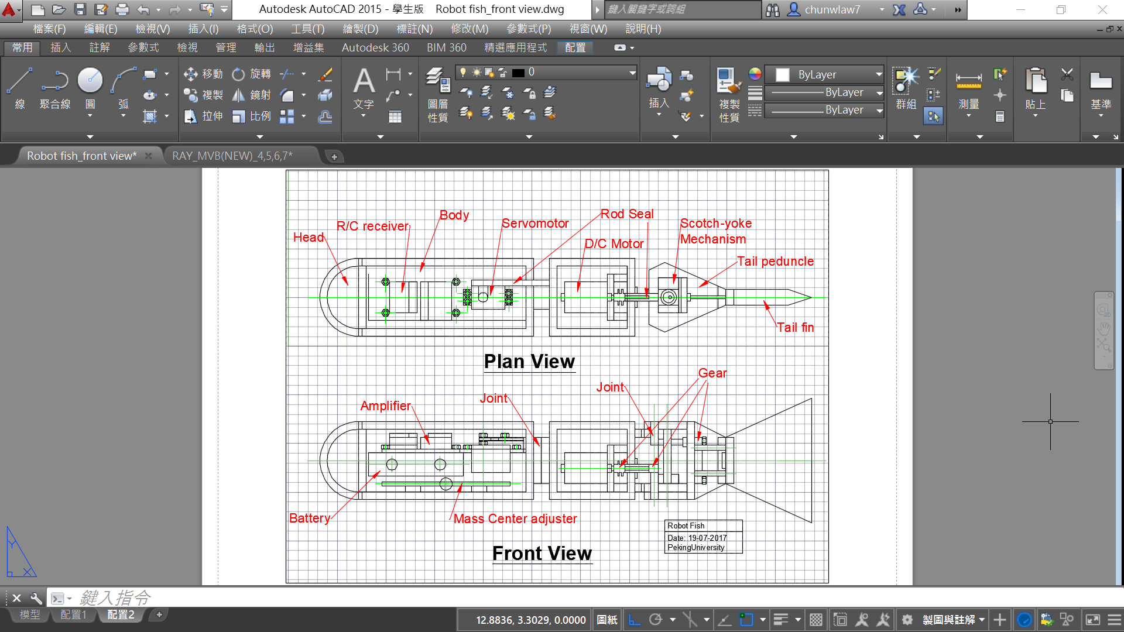
Design

Slide 11
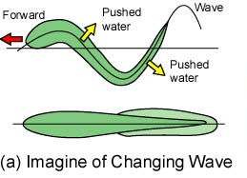
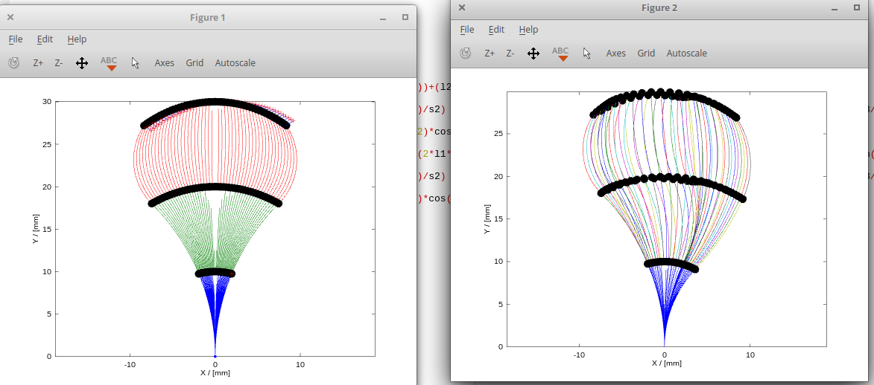
(a) Changing Wave

Slide 12
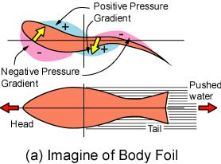
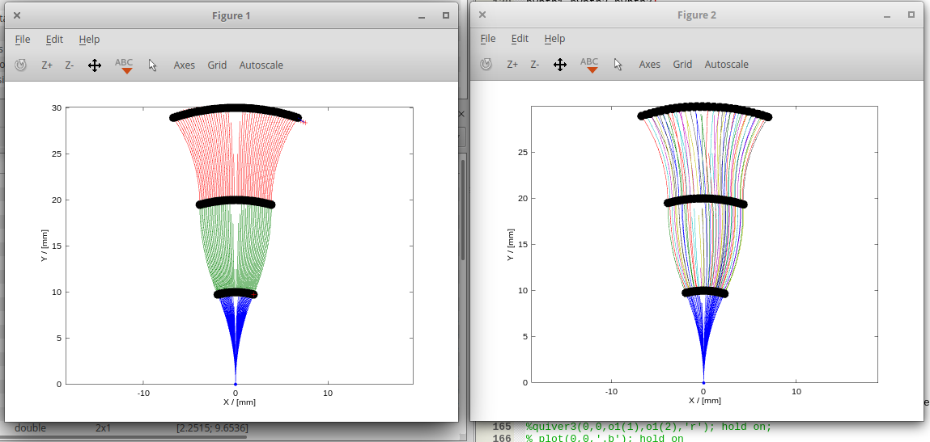
(b) Body Foil

Slide 13
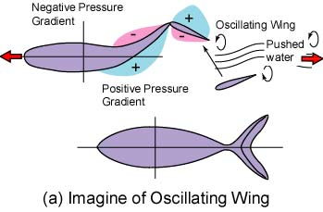
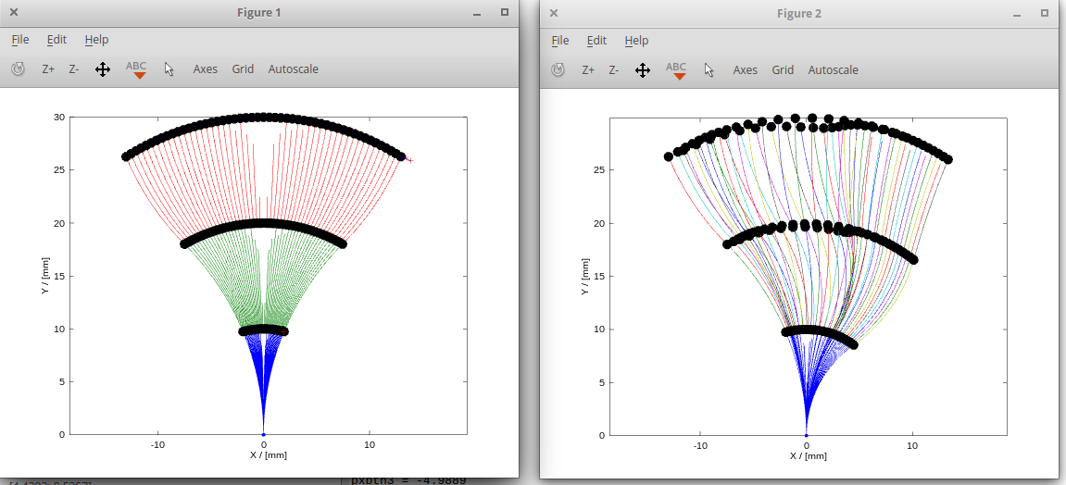
(c) Oscillating Wing

Slide 14
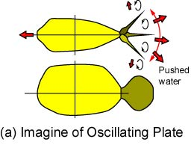
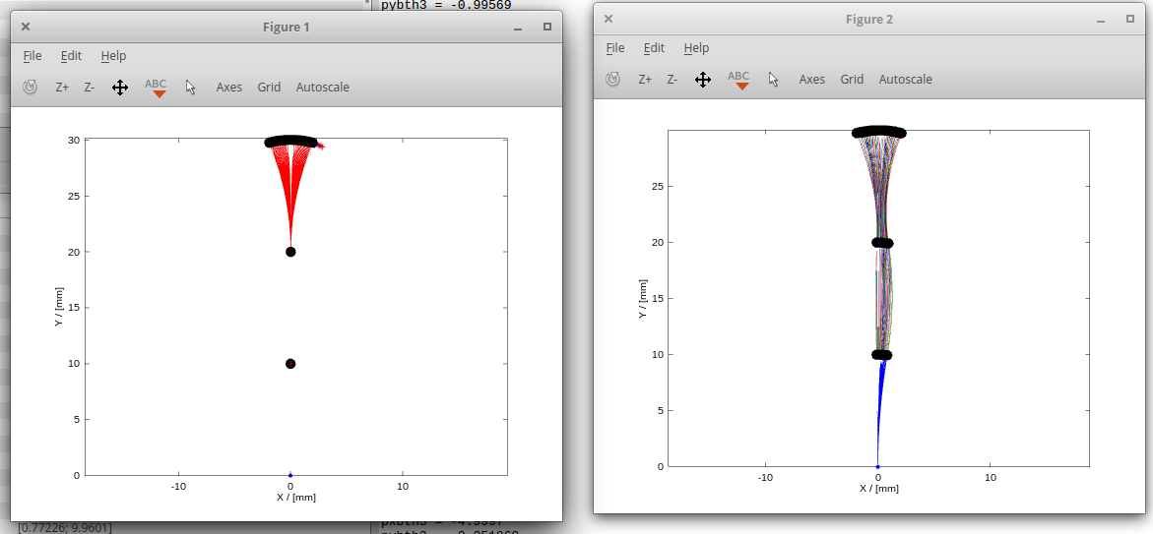
(d) Oscillating Plate

